Slide 1
Division of Enforcement
Anti-Theft and Regulations
Dealer Training
2020

Slide 2
Division of Enforcement Anti-Theft and Regulations
Director
Assistant Director
2 Senior Detectives
10 Detectives
3 Civilian Inspectors
Assigned to different geographic locations and specialties with field offices located in 8 of the 13 BMV Branches

Slide 3
Detective’s Duties
Conducts in-depth investigations pertaining to stolen vehicles, title, license, registration, identity, and insurance fraud and anti-theft matters in order to enforce motor vehicle and criminal laws.
Conducts internal and external investigations in sensitive areas such as theft by employees, municipalities, workers compensation claims, and complaints against motor vehicle employees in order to provide management with facts upon which corrective action can be taken.
Prepares and executes arrests and search warrants; issues summonses; serves suspensions; retrieves plates, licenses, and ID cards; and procures fees in order to enforce applicable laws, rules, and regulations.
Conducts investigations into automobile dealerships in order to ensure compliance with all applicable rules, regulations, and laws.
Conducts in-depth investigations into suspected fraud on petitions for special and related social referendum in order to ensure compliance with appropriate statutory procedures.
Conducts in-depth investigations into suspected cases of odometer and financial fraud in order to enforce motor vehicle and criminal laws.
Conducts investigations into automobile salvage operations including Auto Graveyard and Recycler laws in order to ensure compliance with all applicable rules, regulations, and laws.

Slide 4
Some Facts about the division of Enforcement
All certified Law Enforcement Officers except for the civilian inspectors.
Investigate and resolve about 4,100+ cases annually.
Average $250,000 in restitution to consumers.
Investigate and prosecute felonies, misdemeanors and infractions.

Slide 5
The Following presentation contains some of the rules and laws that a dealer must follow.
Please refer to the following for more detailed guidance:
M.R.S.A Title 30-A
M.R.S.A Title 29-A
M.R.S.A TItle 17
M.R.S.A Title 17-A
M.R.S.A Title 11
M.R.S.A Title 10
M.R.S.A Title 5
Secretary of State Rules and Regulations Chapter 103 and Chapter 104.

Slide 6
Facility Requirements Primary location
Application and additional fees required.
Lease if area is not owned by the dealer
Land Use /Zoning approval
Must meet the Following requirements:
Business hours posted (Min 30hrs per week) (Five-6 Hr. Days between 6am and 9pm) *NOTE* A dealer may be exempted from regular hours for up to two weeks with written notification to Dealer Licensing Division.
5,000 sq.´ Display area (mowed, plowed, and free of debris)
400 sq.´ Repair Facility (Workable Floor Space, and heated)
64 sq.´ Office Space (desk, 2 chairs, and a file cabinet)
12 sq.´ Sign permanently mounted and readable from 200’
NOTE: Please See Dealer Rules for all requirements

Slide 7
Multiple Locations
Annex Location:
Must meet the same requirements as the primary
place of business
Application and additional fees required.
Lease if area is not owned by the dealer
Land Use /Zoning approval
Records may be kept at the primary location.

Slide 8
Multiple Locations
Secondary Location:
Lease if area not owned by the dealer
Land Use/Zoning form
Space enough to display at least two (2) vehicles.
Sign that meets same requirements as primary
Application and additional fees required
No mileage restriction from primary location, but
must offer a warranty facility within 50 miles.

Slide 9
Sales Promotion
Attended Sales Promotion:
1. Notify BMV of the proposed dates and locations of display.
2. Fees: $ 50 for 7 days or less promotion.
$100 for an 8-60 day promotion.
$150 for more than 60 days, but less than 90 days promotion.
3. May be used in multiple locations.
4. Equipment and Trailer dealers are exempt from obtaining this
permit unless they are displaying a motor vehicle or the display
is more than 90 continuous days.
Unattended Sales Promotion:
1. BMV must receive a written contract with the
name of the sponsor and dealership.
2. Fees: $ 50 for 7 days or less promotion.
$100 for an 8-60 day promotion.
$150 for more than a 60 day promotion.
3. Equipment and Trailer dealers are exempt from obtaining this
permit unless they are displaying a motor vehicle or the display
is more than 90 continuous days.

Slide 10
Sales Promotion
Attended and Unattended Sales Promotions require:
A completed MVD-379 Zoning Form from the town the promotion is occurring;
A signed contract agreement with property owner.
All promotion requests require minimum notice accepted~ 48 Hrs

Slide 11
Sales Promotion
Charitable Events
-Charitable event permits will be EXEMPT from fees for attended and unattended sales promotions.
-Organization and/or sponsor information must be provided!
-The sponsor’s name, location, and date (s) of the event being held.
Minimum Notice Accepted ~48hrs

Slide 12
Dealer License Renewals
Mediation/Arbitration Fees:
Dealers must collect arbitration $1 fee for every motor vehicle sold to a retail customer, including new and used vehicles. These fees must be paid for the 12 month period of the issued dealer’s license.
Dealers must list the fee on the sales agreement separately.
Exceptions:
Mobile homes and commercial vehicles with a G.V.W. of 8,500 lbs. or more.
Remember: Notify the Dealer Section with in 30 days of any changes!

Slide 13
Keep Accurate Records
Make copies of ALL your paperwork and maintain at the primary established place of business.
Dealers must maintain a temporary plate log (Form MVI-0110A). The log must include voided plates!
Keep white/pink copies of the NOS (Notice of Sales) organized and available.
Dealership records MUST be kept for 5 years minimum.
Remember: Keep a temporary plate log!

Slide 14
When not to sell vehicles
A licensed car dealer may not be open for business on the following days:
ALL SUNDAYS
Easter
Christmas
Thanksgiving
Exemption from the Blue Law: Camping Trailers and new Motorhomes. Title 17 Section 3203 & 3203A.
Notes:
When not to sell vehicles:
A licensed car dealer may not sell vehicles on the following days:
Christmas
Easter
Sundays
Thanksgiving
Exemption from the Blue Law: Camping Trailers and new Motor Homes. Title 17 Section 3203 & 3203A.
Text advances automatically
Click to advance to the next screen

Slide 15
THE USED CAR INFORMATION ACT
10 M.R.S.A §1474 THRU §1477
Notes:
This is a small group of laws that has had a big impact on the auto sales industry.
The industry used to be wide open and “buyer beware” when it came to dealers. Older dealers used to tell me about going on every dealers lot and finding all of the odometers set at zero. It was felt that a car coming from a dealer was a “new “ car and the mileage should reflect that

Slide 16
What does the Used Car Information Act do?
Sets minimum warranties on used cars
Sets disclosure standards on used cars
Notes:
Does everyone know what a warranty is?
What is the minimum warranty required in Maine? Get Answers
What is disclosure?

Slide 17
The Used Car Information Act applies to:
USED automobiles
USED trucks under 10,000 lbs.
Notes:
Note the USED part

Slide 18
The Used Car Information Act does not apply to:
New vehicles (Never titled or registered)
Trucks over 10,000 lbs.
Motorcycles
Notes:
There is a disclosure for New cars but it is covered in other areas
Motorcycles are not covered anywhere

Slide 19
Who is affected by the Used Car Information Act?
All Dealers, whether licensed or unlicensed
Dealers licensed in another state, doing business in Maine
Finance Companies and banks who resell their own repossessed vehicles to the public
Notes:
Note licensed or unlicensed
Auction attendees are under obligation
finance companies have the exact requirements that dealers have, inspection and disclosure

Slide 20
The Only Exception to the Used Car Information Act
Vehicles sold for a purpose other than transportation
A Parts Vehicle
A Junk Vehicle
Evidence outside of the contract that contradicts this will be admissible
Notes:
Talk about Thurber v. Bill Martin Chevrolet and why this came about

Slide 21
Used Vehicle Buyer’s Guide
A combination of Disclosure and Warranty statement
Originally two forms, then the Secretary of State went to the FTC and combined them
The most important document the dealer has for protection
Notes:
Talk about the “none/none” sticker and the warranty sticker required in all states.
Why is it important to dealer?
It provides insurance that they won’t have to buy the car back,
IF DONE HONSETLY AND PROPERLY

Slide 22
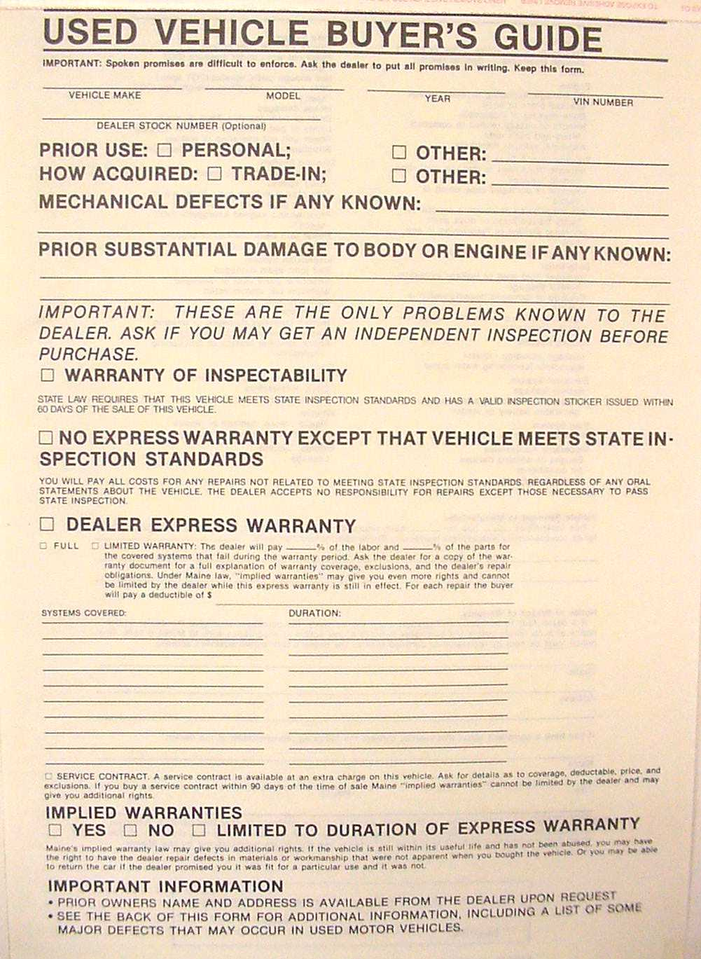
This form cannot be obtained through The Bureau of Motor Vehicles.

Slide 23
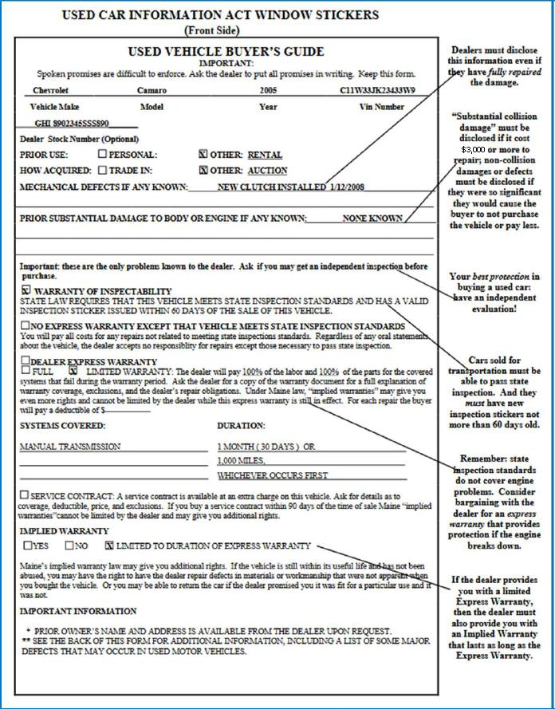
Detailed description of how to fill out buyers guide.

Slide 24
The Disclosure Statement
All VIN Digits
OPTIONAL
Notes:
Disclosure
Full VIN
Make model year etc.
Prior Use Personal or other
How acquired
Mechanical defects
Prior damage

Slide 25
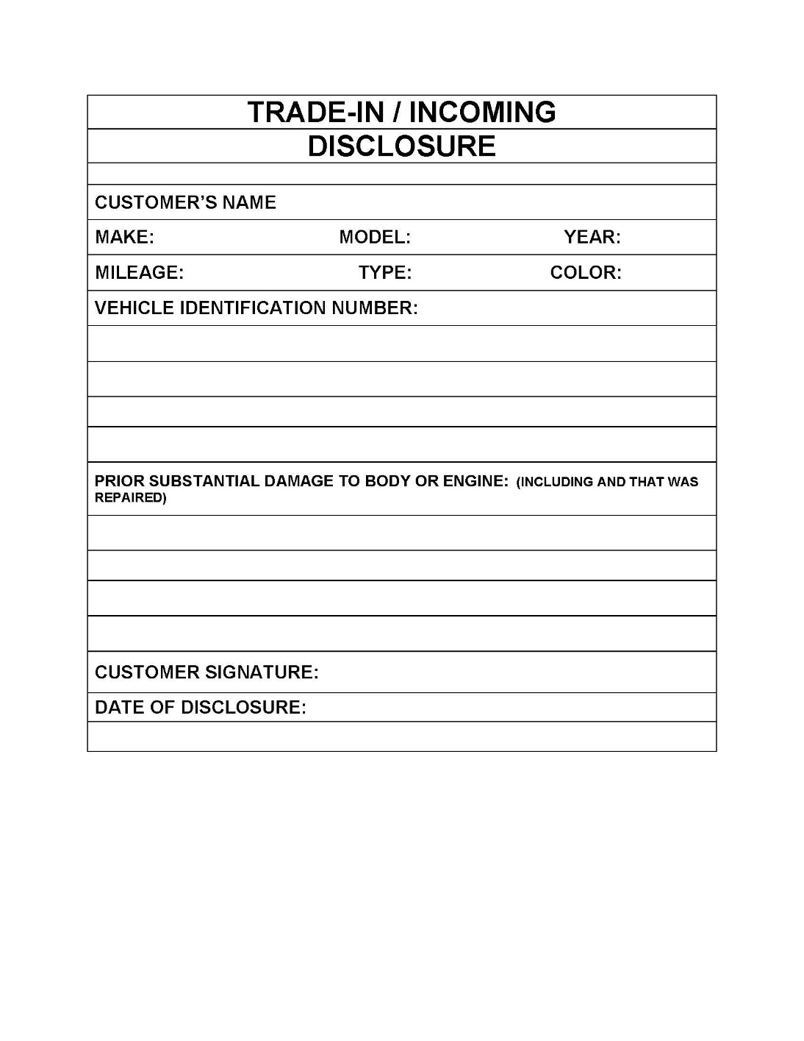
Disclosure
The dealer is required to have an incoming disclosure from the prior owner.
If purchased in a dealer to dealer sale or at an auction the buyer will receive a Used Car Buyers Guide from the selling dealer.
*****A copy of the UCBG must be kept with the sales file as proof of incoming disclosure from the auction or previous dealer.********
A dealer who purchases vehicle directly from the previous owner will obtain a signed and dated incoming disclosure statement from that owner. (does not have to be on a UCBG)

Slide 26
Incoming Disclosure Exception
Vehicle purchased by dealer at an out-of-state DEALER ONLY! auction…
When you draft your UCBG to post in the vehicle it MUST state that it was purchased at
“ OUT-OF-STATE AUCTION”
AND
the VEHICLE HISTORY is UNKNOWN

Slide 27
What must be disclosed?
The prior use of the vehicle (Examples)
Rental
Taxi
Police Car

Slide 28
How was the vehicle acquired?
Dealer Auction…Out of State
Dealer Auction...In State
Dealer Sale
Trade-in
Repossession
Notes:
Repossession is important because it will give a benefit

Slide 29
Mechanical Defects that must be disclosed
Major Mechanical defects
Engine
Transmission, etc.
Notes:
These must be disclosed even if fully repaired
example of a corvette with a replaced motor
Is an odometer replacement a Major Defect.
Something to think about

Slide 30
Odometer Replaced
Replaced or Repaired
Must be set to zero
Or set to the actual mileage of the vehicle
If set to zero, Contact Office of Investigation:
Must obtain a sticker to be put on the forward doorpost, driver’s side
Cannot be a junkyard odometer with mileage on it…

Slide 31
Odometer Replaced
Disclose the replaced odometer on the UCBG as a mechanical defect
The title will be branded as odometer change if it is set to zero,
“NOT ACTUAL MILEAGE”

Slide 32
Disclosure of Prior Damage
Fire
Water
Vandalism
Collision
When the cost to repair is $3000 or more AT RETAIL
Notes:
Note the RETAIL
The minimum has bounced around for several years but has landed at $3000
Flood damaged cars are still a problem coming from the south

Slide 33
Repossessed Vehicles
Are exempt from disclosure unless the dealer should be expected to know of damage.
Notes:
Nobody ever chased the repo man in his wrecker to tell him about damage!

Slide 34
What if the title is branded?
The brand on the title must be disclosed
Repaired
Rebuilt
Rebuilt Salvage
Odometer Replaced

Slide 35
Buying, Selling and Repairing Salvage Vehicles
The Used Car Buyers Guide must state “SALVAGE VEHICLE”
Must have a recyclers license
Failure to do so is a Class D Crime
Please See Slide 85-101 for Recycler License Requirements
Notes:
Must be in those words!!

Slide 36
The Warranty Statement
Notes:
This is the warranty portion of the program
there is still a lot of stuff, but we whittled off quite a bit by removing the disclosure
Up to now, all of the disclosure covered applied to dealer -to -dealer as well as dealer to public sales,
The warranty does not apply to dealer to dealer sales.

Slide 37
Safety Inspection
Warranty that the vehicle will meet inspection standards at the time of sale
Inspection sticker can not be more than 60 days old at time of sale!
Notes:
1. When you take in a car you must first remove the inspection sticker
2 Then you must have it re-inspected
If you have the car longer than 60 days, you do not need to re-inspect, until you sell it. Then the sticker must have been issued within the past 60 days

Slide 38
Warranty
The Minimum is the Safety Inspection
This cannot be waived by either party
Notes:
This is a warranty that says that the car meets safety inspection standards as it sits, and that it has a new inspection sticker issued within the past 60 days

Slide 39
Warranty of Inspection
This is NOT a 30 Day/1000 Mile Warranty
It DOES mean that the vehicle
Legitimately passed inspection
Meets Inspection Standards on the date of sale

Slide 40
No Express Warranty
This block is checked when the only warranty given is the Inspection Warranty

Slide 41
Dealer Express Warranty
Full
This is the factory warranty
Limited
Labor and parts percentage must be entered
Deductible must be entered
Notes:
Full warranty comes with some program cars
Caution not to sell an aftermarket warranty to someone who has a remainder of factory warranty. This can be expensive.
You may give your own warranty to coincide with a full warranty, but if you sell one, you have to disclose that it will not be effective until the full warranty is expired

Slide 42
Systems Covered
This must be specific (This Protects the Dealer)
Motor
Transmission
Rear end, etc.
DO NOT USE “DRIVE TRAIN”, “POWER TRAIN” etc.

Slide 43
Duration
Duration of the warranty
In miles
In time

Slide 44
Implied Warranty
Applies to vehicles that are
less than 4 years old
still within the normal useful life, in mileage
“Warranty of Merchantability”

Slide 45
Implied Warranty
Used vehicles are the only consumer good sold in Maine that the seller is not required to sell with an implied warranty

Slide 46
Implied Warranty
Must be given if an express warranty is given, but it can be limited to the duration of the express warranty

Slide 47
Service Contract
If the dealer sells a Service Contract
check the Service Contract block
Check “Yes” or “Limited to the Duration of the Express Warranty”

Slide 48
An Important Point
The name and address of the prior owner must be given if requested
This does not violate any privacy laws

Slide 49
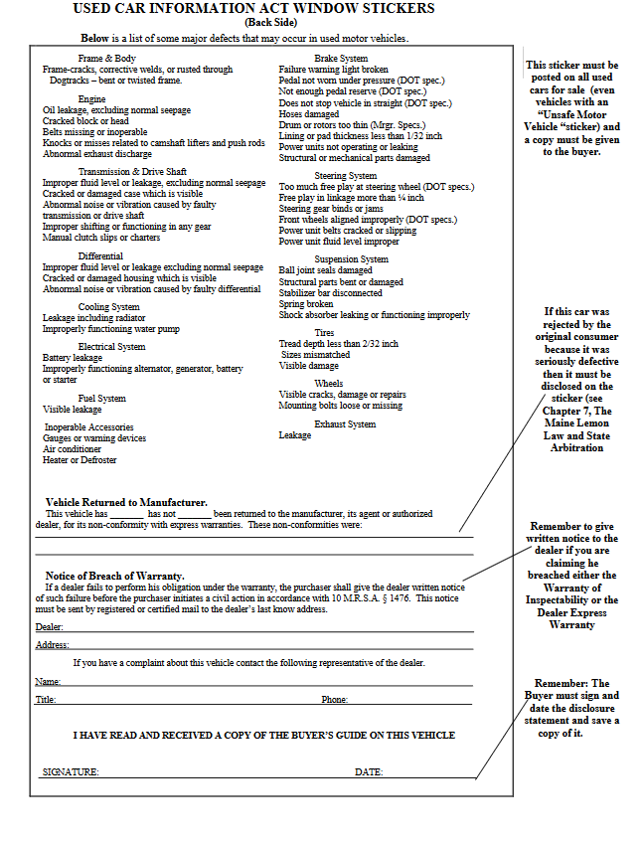
Make sure to write in location warranty work is to be completed.
Make sure the customer signs here. ( This is the customer acknowledging the condition of the vehicle and warranty at time of sale)

Slide 50
Vehicle Returned to Manufacturer
This vehicle was accepted into a Lemon Law Arbitration Program
AND
Was purchased back by the manufacturer
Notes:
Disclosure is required if the vehicle is accepted into the arbitration program, whether it is declared a lemon or there was a negotiated settlement prior to a hearing.

Slide 51
Notice of Breach of Warranty
The buyer must be told where to send notice of breach of warranty

Slide 52
Signature!!
If it isn’t signed it didn’t happen!!

Slide 53
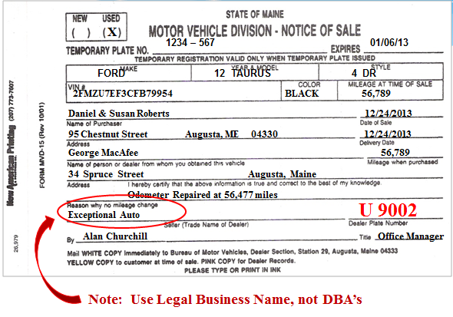
Notice of Sale MVD-15

Slide 54
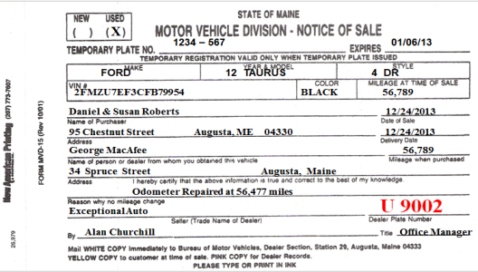
Notice of Sale MVD-15
Must be completed when issuing a temporary registration to a customer
MVD-15 must be legible!
The white and/or pink copy (s) must be kept for five (5)
years.
The yellow copy is given to the buyer.
Please do not cross out, white out, write over,
strike over, erase etc.
If an error occurs, please redo the form.
Notes:
Notice of Sale
MVD-15
MVD-15 must be legible!
The white and/or pink copy (s) must be kept for five (5)
years.
The yellow copy is given to the buyer.
Please do not cross out, white out, write over,
strike over, erase etc.
If an error occurs, please redo the form.
Arbitration fees are based on the number of retail sales.

Slide 55
Temporary Registration Plates
Dealers must keep a written record of temporary plates, including all destroyed or voided plates.
Please do not share your inventory with other dealers. These plates have been assigned solely to your dealership.
Only the Dealer Division at BMV can authorize expiration extensions beyond the valid 14 days.
Temporary Plates cost $1 each and can be obtained at any BMV Branch Office or the Stockroom.
Temporary plates ordered by phone with a cc must be in increments of 25.
Please bring a copy of your Dealer License and Identification.
Notes:
Temporary Registration Plates
Temporary Plates cost $1 each and can be obtained at any BMV Branch Office or the Stockroom.
* Please bring a copy of your Dealer License and Identification.
Dealers must keep a written record of temporary plates, including all destroyed or voided plates.
Please do not share your inventory with other dealers. These plates have been assigned solely to your dealership.
Only the Dealer Division at BMV can authorize
expiration extensions beyond the valid 14 days.

Slide 56
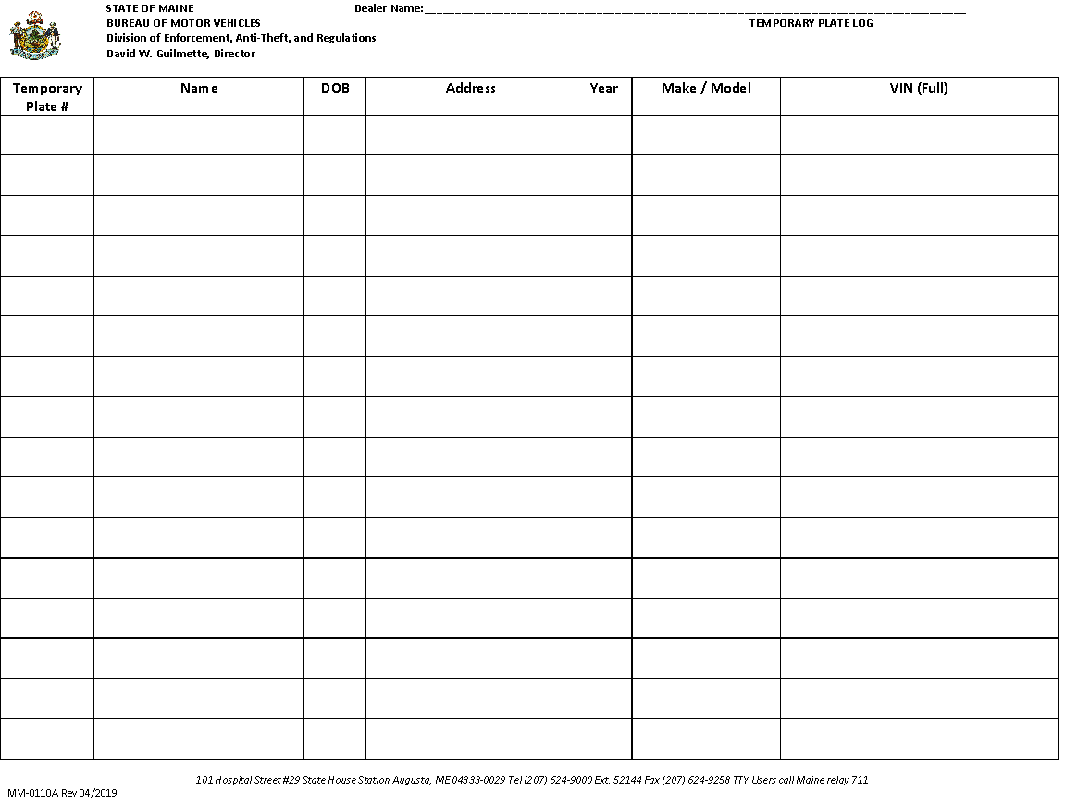
Temporary Registration Plates
Dealers must submit their temporary plate log annually
with license renewals.

Slide 57
Record Keeping
Signed copy of incoming disclosure
Signed copy of Used Car Buyer’s Guide
Must be kept for five years

Slide 58
Can a Dealer sell an UNSAFE vehicle?
YES…BUT
Must have an “Unsafe Motor Vehicle” Form
!!This does not mean there is no inspection!!
**The inspection was done and it failed**

Slide 59
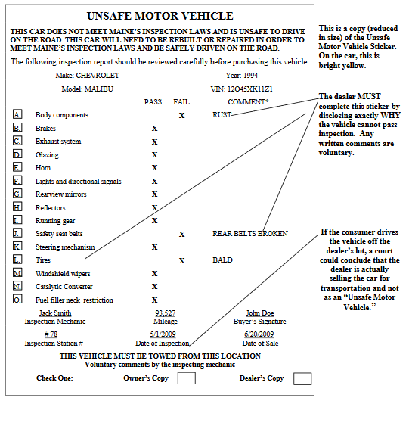
!!!!!MUST BE COMPLETED BY A LICENSED INSPECTION MECHANIC!!!!!!

Slide 60
Unsafe Vehicle
MUST NOT be test driven
MUST NOT be driven from the dealership
MUST NOT be issued a 14 day plate
MUST NOT have any inspection sticker
MUST BE TOWED/TRAILERED FROM THE LOT

Slide 61
The Unsafe Vehicle Form MUST
be completed by a licensed inspection mechanic
at a licensed inspection station, and
be a true inspection

Slide 62
When an “unsafe Motor Vehicle is sold...
Complete the disclosure portion of the Buyer’s Guide
“Unsafe Vehicle” in the Mechanical Defects Section
No Warranties

Slide 63
The Dealer must…
Remove any prior inspection sticker
AND
Put his own inspection sticker on
before displaying the vehicle for sale

Slide 64
Possible Sanctions against Dealers
Court Action
Civil Penalties
Private lawsuits
Unfair Trade Practice Act
Any of the above sanctions can result in
revocation of dealer license!

Slide 65
Safety Inspections
Example #1
Vehicle obtained: Operated from place of purchase to dealership (or inspection station).
Vehicle inspected and PASSED the inspection
-Old Inspection sticker removed,
-New inspection sticker affixed to windshield,
-Buyers Guide affixed to side window,
warranty of inspection minimum.

Slide 66
Safety Inspection Cont:
Vehicle may be sold with a temporary plate.
Buyer accepts vehicle with Warranty of Inspectability at the time of sale.

Slide 67
Safety Inspection Example #2
Vehicle obtained: Operated from place of purchase to dealership (or inspection station).
Vehicle inspected and FAILS the inspection
- Old inspection sticker removed,
- Complete “Unsafe Motor Vehicle Inspection
form and affix to side window,
- May not be operated on a public way
(Dealer)
- Affix Buyers Guide to side window, with
No Warranty of Inspectability

Slide 68
Safety Inspection Cont:
Vehicle may be sold retail as an “Unsafe Vehicle”
BUT
May not be operated on the public way, (Buyer)
May not issued a temporary plate,
Must be towed from the lot.

Slide 69
Use of Dealer Plates
Directly connected with the business of
Buying Selling
Testing Adjusting
Servicing Demonstrating
Exchanging

Slide 70
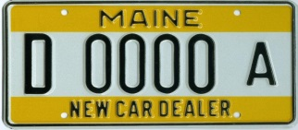
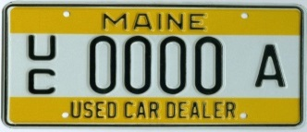
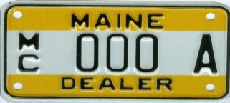
Use of Dealer Plates
New, Used Car or Motorcycle Dealer Plate
These plates are issued to dealers to allow a customer to road test a vehicle.
A business plate may be used by the owner or a sales representative, general manager, sales manager, or service manager who are employees on the dealers payroll full-time, but not in the dealer’s immediate family or members of that person’s household.
Must only be attached to a vehicle in the dealer inventory
Dealer plates may not be loaned out or leased to another party they are for the sole use of the licensed dealer.
Notes:
New, Used Car or Motorcycle Dealer Plate:
These plates are issued to dealers to allow a customer to road test a vehicle.
A business plate may be used by the owner or a sales representative, general manager, sales manager, or service manager who are employees on the dealers payroll full-time, but not in the dealer’s immediate family or members of that person’s household.
Law: Section 1002, Paragraph D.
Page 131

Slide 71
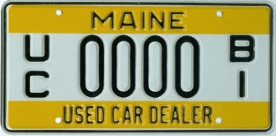
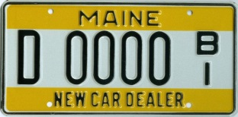
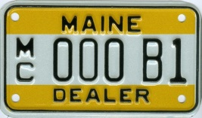
Use of Dealer Plates
New, Used Car or Motorcycle Family Plate:
This is for the personal use of the dealer’s immediate family, provided the dealer is married or has children, (under 18), that have a valid driver’s license and reside full-time in the dealers residence.
Must submit application identifying family members that will be using the family plate(s).
Owners/Partners must hold at least 20% ownership in dealership.
Only one (1) family plate is allowed per owner.
Common law marriages do not apply.
Notes:
Use of Dealer Plates
New, Used Car or Motorcycle Family Plate:
This is for the personal use of the dealer’s immediate family, provided the dealer is married or has children, (under 18), that have a valid driver’s license and reside full-time in the dealers residence.
Must make or submit an application in spouse or child under 18 with a valid Maine driver’s license.
Must own at least 20% of the dealership.
Only one (1) family plate is allowed per owner.
Common law marriages do not apply.

Slide 72
Use of Dealer Plates
New, Used Car or Motorcycle Family Plate:
Vehicle must be in the dealer’s active inventory.
May Not be used for employment purposes i.e., mail carrier, Mary Kay, Real Estate Agent.
Must have a dealer license for one (1) year to qualify.
May not be used on a Motor Home.
Notes:
Use of Dealer Plates
New, Used Car or Motorcycle Family Plate:
Must be in the dealer’s active inventory.
Can not be used for employment purposes.
Must have a dealer license for one (1) year to qualify.
May not be used on a Motor Home.
.

Slide 73
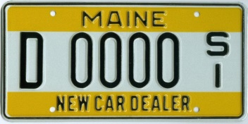
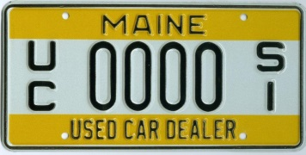
Use of Dealer Plates
New, Used Car Service Plate:
These plates May Not be used by a customer.
Its purpose is for the servicing and/or
picking up parts as part of the dealers business.
A vehicle to which the service plate is attached, must have the name of the licensed dealership on the vehicle’s side in letters at least 3 inches in height.
The use of this plate May Not exceed 24,000 lbs.
Notes:
New, Used Car Service Plate:
These plates can not be used by a customer.
Its purpose is for the servicing and/or
picking up parts.
A vehicle to which the service plate is attached, must have the name of the licensed dealership on the vehicle’s side in letters at least 3 inches in height.
The use of this plate can not exceed 24,000 lbs.

Slide 74
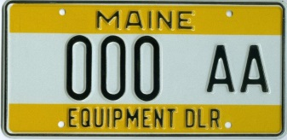
Use of Dealer Plates
Equipment Dealer Plate
This plate is for the purpose of demonstrating/delivering equipment to customers.
This plate May Not be used on company vehicles, (IE: Trucks, cars, ETC.)
This plate can not be used on equipment, on a public way, that is being rented or leased.
If you are renting or leasing equipment, you must register these as special mobile equipment or special equipment.
Notes:
Use of Dealer Plates
Equipment Dealer Plate:
This plate is for the purpose of demonstrating equipment to customers.
This can not be used on equipment that is being rented or leased.
If you are renting or leasing equipment, you must register these as special mobile equipment or special equipment.

Slide 75
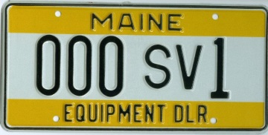
Use of Dealer Plates
Equipment Service Plate
Truck use only.
This plate is for the servicing of equipment and/or p
icking up parts. This May Not be used by a customer.
A vehicle to which the service plate is attached, must have the name of the licensed dealership on the vehicle’s side in letters at least 3 inches in height.
The use of this plate can exceed 24,000 lbs.
Notes:
Use of Dealer Plates
Equipment Service Plate:
Truck use only.
This plate is for the servicing of equipment and/or picking up parts. This can not be used by a customer.
A vehicle to which the service plate is attached, must have the name of the licensed dealership on the vehicle’s side in letters at least 3 inches in height.
The use of this plate can exceed 24,000 lbs.

Slide 76
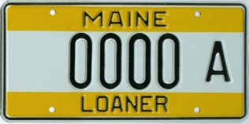
Use of Dealer Plates
Loaner Plate:
- To be used by a customer for a period of 7 days while their vehicle is being repaired.
- If the repairs are going to take more than 7 days you must contact this office for an extension of this plate, which May Not exceed 30 days.
- A loaner plate log must be maintained by the dealership listing name, address, make, model, VIN, plate number, the customer’s vehicle make, model, VIN, and the effective date of the loaner assignment.
- Please remember that the customers registration and any other credentials for the customers vehicle must be carried in the loaner vehicle.
- This plate May Not be used by the dealer or its employees.
- A customer May Not be charged a fee for the use of a vehicle with a loaner plate.
- If a fee is charged then you must register the vehicles as short-term rental vehicles.
Notes:
Use of Dealer Plates
Loaner Plate:
To be used by a customer for a period of 7 days while their vehicle is being repaired.
If the repairs are going to take more than 7 days you must contact this office for an extension of this plate, which can not exceed 30 days.
A loaner plate log must be maintained by the dealership listing name, address, make, model, VIN, plate number, the customer’s vehicle make, model, VIN, and the effective date of the loaner assignment.
Please remember that the customers registration and any other credentials for the customers vehicle must be carried in the loaner vehicle.
This plate can not be used by the dealer or its employees.
A customer can not be charged a fee for the use of a vehicle with a loaner plate.
If a fee is charged then you must register the vehicles as short-term rental vehicles.

Slide 77
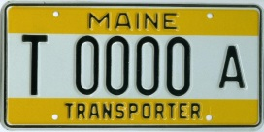
Use of Dealer Plates
Transporter Plate:
This plate is for repair facilities, body shops, banks, credit unions or other financial institutions, motor vehicle auction business, public or non-profit organizations.
This plate May Not be used by a customer or for demonstration purposes.
It is merely to get a vehicle from point A to point B.
Notes:
Use of Dealer Plates
Transporter Plate:
This plate is for repair facilities, body shops, banks, credit unions or other financial institutions, motor vehicle auction business, public or non-profit organizations.
This plate can not be used by a customer or for demonstration purposes.
It is merely to get a vehicle from point A to point B.

Slide 78
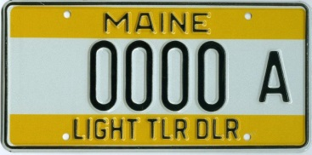
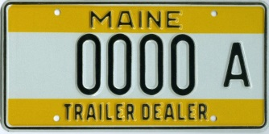
Use of Dealer Plates
Light Trailer and Heavy Trailer Plate:
This plate allows the movement of trailers from one point to another, i.e. from the manufacturer, auction site or place of purchase to your facility.
A trailer May Not carry a load on a dealer plate.
A trailer dealer can obtain a permit to demonstrate with their dealer plate up to 10,000 lbs.
Notes:
Use of Dealer Plates
Light Trailer and Heavy Trailer Plate:
This plate allows the movement of trailers from one point to another, i.e. from the manufacturer, auction site or place of purchase to your facility.
A trailer can not carry a load on a dealer plate.

Slide 79
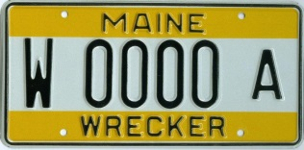
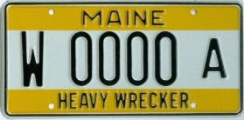
Use of Dealer Plates
Light Wrecker and Heavy Wrecker:
* These plates allows a dealer to transport a vehicle belonging to his dealership from point A to point B that may be deemed unsafe or wrecked or perhaps purchased at auction.
* These plates May Not be used for roadside assistance or for “in rotation” calls for police departments.
* A wrecker by design is equipped with a hoist apparatus or special equipment designed and used for towing or carrying one wrecked or disabled vehicle.
* The light wrecker plate May Not exceed 26,000 lbs.
* The heavy wrecker plate May Not exceed 80,000 lbs.
Notes:
Use of Dealer Plates
Light Wrecker and Heavy Wrecker:
These plates allows a dealer to transport a vehicle belonging to his dealership from point A to point B that
may be deemed unsafe or wrecked or perhaps purchased at auction.
*These plates can not be used for roadside assistance or for “in rotation” calls for police departments.
A wrecker by design is equipped with a hoist apparatus or special equipment designed and used for towing or
carrying wrecked or disabled vehicles.
*The light wrecker plate can not exceed 26,000 lbs.
* he heavy wrecker plate can not exceed 80,000 lbs.

Slide 80
Experiment Plates
Experiment:
Motor Vehicle Inventor must register an application with the Secretary of State as an Inventor.
Submit pictures of the experimental vehicle in development.
Submit a copy of the insurance policy.
Once approved, up to 2 plates will be issued to the inventor for an annual fee of $20 for each plate issued.
The plates may be used on multiple vehicles, similar to dealer plates.
This plate is stamped EXPERIMENT and looks like a dealer plate.
Notes:
Experiment Plates
Experiment:
Motor Vehicle Inventor must register an application with the Secretary of State as an Inventor.
Submit pictures of the experimental vehicle in development.
Submit a copy of the insurance policy.
Once approved, up to 2 plates will be issued to the inventor for an annual fee of $20 for each plate issued.
The plates may be used on multiple vehicles, similar to dealer plates.
This plate is stamped EXPERIMENT and looks like a dealer plate.

Slide 81
Permit to Demonstrate
A request for a Permit to Demonstrate
must be submitted with the complete
VIN of the vehicle being demonstrated.
Issued for seven (7) days only.
May Not be used on leased or rented vehicles.
This permit is only valid when issued by this office.
Processing fee: $1.00
May Not be issued more than once to the person or business per vehicle.
A properly issued permit allows the truck to show it can carry a load of goods.
Notes:
Permit to Demonstrate
A Permit to Demonstrate must be submitted with the complete VIN of the vehicle being demonstrated.
Given only for seven (7) days and
Cannot be used on leased or rented vehicles.
This permit is only valid when a BMV official signs it.
Processing fee: $1.00
Cannot be issued more than once to the person or business per vehicle.
An issued permit allows the truck to show it can carry a load of goods.

Slide 82
10K Laden Permit
Maine dealers licensed as a new car, used car, or equipment, and a heavy trailer dealer can purchase a 10K permit to operate a laden vehicle over 10,000 pounds.
The load must consist of only one (1) automobile, truck or truck tractor or multiple trailers or equipment that a dealer is licensed to sell.
$200 fee valid for 90 Days.
Notes:
10K Laden Permit
Maine dealers licensed as a new car, used car, or equipment, and a heavy trailer dealer can purchase a 10K permit to operate a laden vehicle over 10,000 pounds.
The load must consist of only one (1) automobile, truck or truck tractor or multiple trailers or equipment that a dealer is licensed to sell.
$200 fee valid for one (1) year.

Slide 83
Reduce or Increase Dealer Plates
Reduction of Dealer Plates:
A dealership must sell 12 vehicles in a 12 month period, if not, there will be a reduction of their dealer plates to; two (2) plates. The reduction includes family and service plates; for which the family plate would be required to be surrendered.
Increase of Dealer Plates:
Additional dealer business plates may be obtained once the Dealer Section at BMV verifies the total sales for a time period to calculate the number of business plates that a dealership may have.
Notes:
Reduce or Increase Dealer Plates
Reduction of Dealer Plates:
A dealership must sell 12 vehicles in a 12 month period, or there is a reduction of their dealer plates to two (2) plates including any family and service plates; for which the family plate would be required to be surrendered.
Increase of Dealer Plates:
Additional dealer business plates may be obtained once the Dealer Section at BMV verifies the total sales for a time period to calculate the number of business plates that a dealership may have.
Another good reason to mail in MVD-15’s Notice Sales to the Dealer Section in a timely manner.

Slide 84
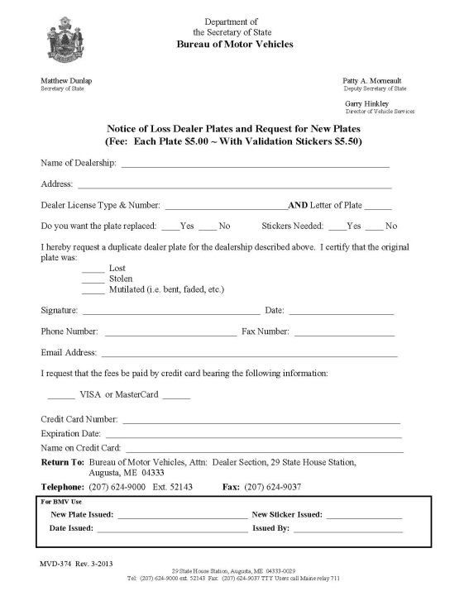
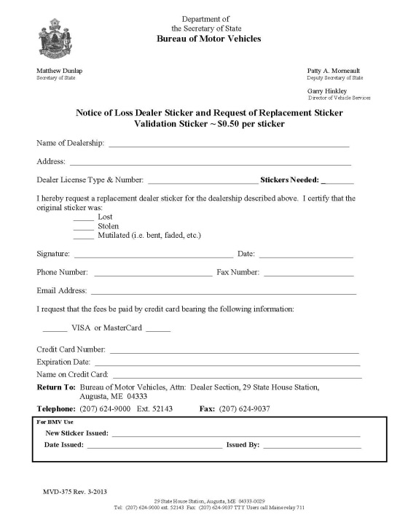
Loss of Dealer Plates MVD-374 & MVD-375
Please complete one of the following forms if a dealer plate becomes lost, mutilated, or destroyed and include $5 per plate and $0.50 per validation sticker.
If lost or stolen, you must notify local law enforcement.
Lost Plate
Lost Sticker
MVD-374
MVD-375
Notes:
Loss of Dealer Plates
Please complete one of the following forms if a dealer plate becomes lost, mutilated, or destroyed and include $5 per plate and $0.50 per validation sticker.
If stolen, you must notify local law enforcement.

Slide 85
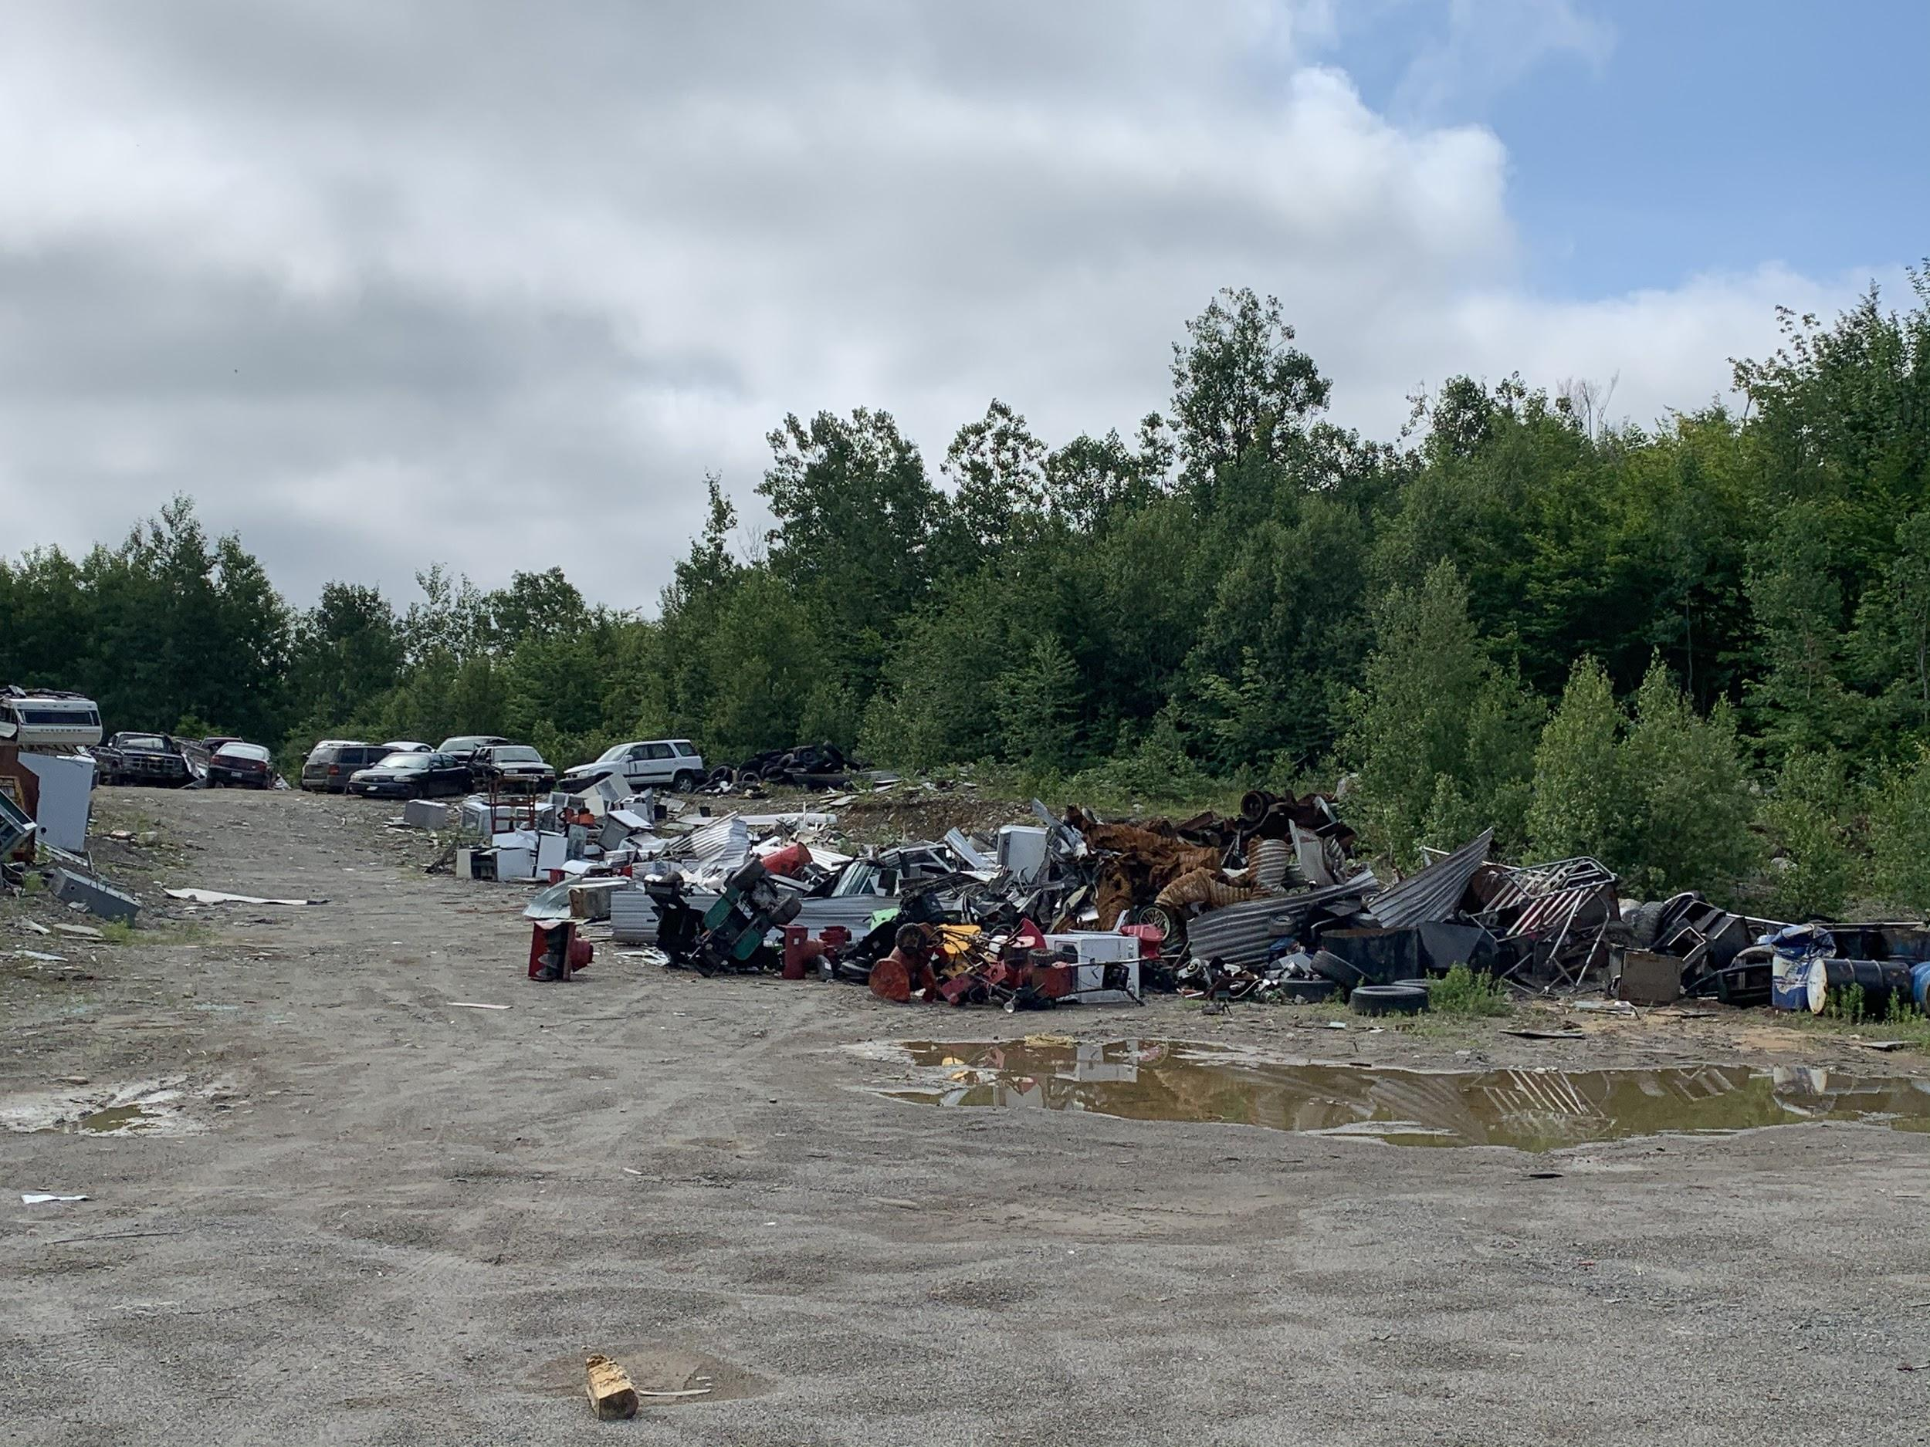
RECYCLER
TRAINING MATERIAL

Slide 86
Why would I need a Recycler License?
I want to be able to purchase or acquire salvage titled vehicles for the purpose of ;
Reselling the vehicle or its component parts;
Rebuilding or repairing the vehicle for the purpose of resale;
Selling the vehicle's basic materials;
Displaying or storing the vehicle or its parts; or
Acting as a scrap processor.

Slide 87
Business Requirements
The established place of business of a recycler shall:
Be a permanent location within the State which is easily accessible and open to the public at all reasonable times:
Is owned or leased by the applicant. If leased, a witnessed or notarized copy of the lease is required to be filed with the application;
2. Have facilities which:
Are adequate for the storage and display of vehicles being handled; and
Facilities and display areas must be reasonably free of debris, hazards and unrelated materials.
3. Have a suitable office which:
Is adequate for business being conducted;
Contains records of the business; and
Is heated and reasonably free of debris, hazards and unrelated materials.
Is separate from any living quarters. Active licenses prior to this date shall be grandfathered and exempt from this requirement.
4. Have business hours which are posted clearly visible to the public;
Are a minimum of 30 hours per week consisting of at least five 6-hour days;
Shall be between 6:00 a.m. and 9:00 p.m.;

Slide 88
Business Requirements Cont...
6. Display the license and supplement license(s) in a public space visible to the general public;
7. Have an exterior sign which meets the following requirements (unless a municipality has established ordinances regulating signs contrary to these rules, whereupon the Secretary of State, upon notification by the dealer of such ordinances, may grant an exception to these rules to the dealer affected):
A.The sign shall be permanently mounted, displayed at the established place of business and shall not be less than 12 square feet in surface size;
B. The sign shall be visible from the entrance to the lot and the letters of the sign shall be readable from a distance of 200 feet; and
C. The sign shall contain the trade or business name of the dealer and related businesses only.

Slide 89
What is a Vehicle?
T29A §101.42 motor vehicle means a self-propelled vehicle not operated exclusively on railroad tracks but does not include, snowmobiles, vehicles designed exclusively for off-road use, and motorized wheelchairs or electronic personal assistive mobility devices.
T29A §602.20 a vehicle means the body or chassis of any vehicle that is to be dismantled, scrapped or rebuilt.
**A motor vehicle is considered a motor vehicle until the certificate of title or the certificate of salvage has been surrendered to the Secretary of State. **

Slide 90
When is a Vehicle considered a Salvage Vehicle?
T29A §667.1 When, by reason of its condition or circumstance, a vehicle for which a certificate of title has been issued by this State is declared a salvage vehicle:
By an insurer, the insurer or its designee shall surrender the certificate of title to the Secretary of State and apply for a certificate of salvage, in accordance with section 654, within 30 days of the settlement of the insurance claim;
By the owner of the vehicle, the owner shall surrender the certificate of title to the Secretary of State and apply for a certificate of salvage in accordance with section 654 prior to the transfer of the vehicle, unless the owner transfers the vehicle to a recycler licensed under this chapter (If an owner transfers a vehicle for which a certificate of salvage has not been issued to a recycler licensed by the Secretary of State, the vehicle is deemed declared by the owner to be a salvage vehicle regardless of condition); or
By a towing company, if the towing company makes clear that the vehicle is a total loss, while claiming the vehicle pursuant to chapter 15, subchapter III. Any certificate of ownership issued to a towing company under section 1856, which the towing company has declared a total loss, must bear the legend "salvage vehicle."

Slide 91
What is a Component Part?
T29A §602.2 component part: "Component part" means one of the following parts of a vehicle:
A. Engine or motor;
B. Transmission;
C. Chassis, front or rear clip, frame or equivalent part;
D. Door;
E. Hood;
F. Tailgate, roof, deck lid or hatchback;
G. Quarter panel or fender;
H. Front fork or crankcase of a motorcycle;
I. Cargo bed, transfer case or sleeper of a truck; or
J. Airbag.

Slide 92
Title Requirements
T29A §651 All motor vehicles that are model year 1995 or newer are required to have a certificate of title; this includes trailers that have a weight exceeding 3000 lbs.
T29A §662-5 Any vehicle received by a recycler must be accompanied by a properly assigned title documents for vehicles that are 1995 or newer. If a title has already been surrendered to the Secretary of State then the recycler can purchase the vehicle without a title. The recycler is responsible for verifying that the title has been surrendered. A recycler that transfers a vehicle to another recycler must ensure that the transfer is completed using a certificate of salvage, unless the title has been surrendered to the Secretary of State (T29A §1111). It is recommended that a recycler receiving a vehicle from another recycler obtain a copy of the recycler license of the selling dealer and a copy of the applicable MVT-103 form, if a title has been surrendered.
T29A §654.2 If a recycler sells a whole salvage vehicle the recycler shall file for a certificate of salvage on behalf of the buyer within 30 days.
T29A §667-3B Recyclers must file for a certificate of salvage within 30 days of receiving a vehicle that does not have a certificate of salvage, unless the prior title is surrendered to the Secretary of State.

Slide 93
Title Requirements Cont...
T29A §1111 A recycler who scraps or dismantles a vehicle shall surrender the certificate of title or certificate of salvage to the Secretary of State for cancellation. T29A §602.4 “dismantled vehicle” means a vehicle with a component part removed.
T29A §602.14 “scrap” means to compress, shred or destroy. *This section does not exempt the recycler for filing for a certificate of salvage or surrender the prior certificate of title to the Secretary of State within 30 days of receiving a vehicle (T29A §667-3B).
T29A §652-18 a recycler may purchase a vehicle that is model year 1995, 1996, 1997, 1998 or 1999 without a certificate of title if:
A recycler, salvage vehicle dealer or scrap processor obtains the seller's name and the address of the seller's residence from a government-issued photograph identification document or credential and maintains the seller's name and address and vehicle identification number of the scrapped vehicle for a period of at least one year; and
A recycler, salvage vehicle dealer or scrap processor reports the destruction of the vehicle to the Secretary of State within 30 days on a properly completed MVT-54 Form.
This subsection applies only to vehicles that are scrapped. For purposes of this subsection, a government-issued photograph identification document or credential includes, but is not limited to, a current and valid United States passport, military identification, driver's license or non-driver identification card.

Slide 94
Record Requirements
29A §1110 Recycler must maintain business records for five years including records of:
The year, make, model, VIN, date of purchase, and name & address of the person or company that the salvage vehicle or component part was bought from - regardless of the year of the vehicle. The year, make, model, VIN, date of sale, and name & address of the person or company that the salvage vehicle or component part was sold to - regardless of the year of the vehicle
The date a vehicle was crushed or shredded, the name of the company that did the crushing/shredding, and the date that the title was surrendered to the Bureau of Motor Vehicles.
*Scrap processors are exempt from the requirements the first requirement but must be in compliance with the second requirement.
*Records must be maintained whether the vehicles or component parts were purchased wholesale, retail or at auction and whether the vehicles are sold, rebuilt, parted out, stockpiled or crushed.
T29A §1110.2 The records, the place of business and the vehicles and vehicle parts in the possession of the licensee must be available for inspection during normal business hour by the Secretary of State, a law enforcement officer or representatives of the office of the Attorney General.

Slide 95
Mobile Crusher
T29A §1102-A A person operating a mobile crusher in this State, whether based in or outside of the State, is subject to licensure by the Secretary of State.
T29A §1110.2 The operator of a mobile crusher shall make the operator’s records available in this state during normal business hours. NOTE A mobile crusher operator must keep a log in a manner prescribed by the Secretary of State for each crush location
Permit Requirement. Mobile crushers must apply for a permit prior to conducting business within the State of Maine. The permit will be issued at no fee and must contain the date(s) and location(s) of the activity. A permit application must be submitted to the Dealer and Agent Services Section at least 48 hours each time prior to conducting business. The permit must be carried with the mobile crusher operator. A mobile crusher being operated at a licensed recycler site is exempt from the permit requirement.
*When conducting mobile crusher operations at an unlicensed location the mobile crusher assumes all of the responsibility for collecting and surrendering certificates of title for each vehicle that is scraped or dismantled.
Mobile crushers must maintain an operator log for each location in accordance with 29-A M.R.S., subchapter 1110. The log must be in a manner prescribed by the Secretary of State.

Slide 96
Other Requirements
T29A §1112 Recyclers/Salvage Dealers cannot possess vehicles, or vehicle parts, from which the Vehicle Identification Number(s) have been removed
T29A §1756 Inspection stickers must be removed from the windshields prior to the sale of a vehicle - or a windshield
T29A §667-4C Recyclers/Salvage Dealers who repair/rebuild salvage vehicles that are 1995 or newer must complete an Affidavit of Repair [MVT-103] reporting whatever repairs were made
T30A §3772 A scrap metal processor shall require the seller to provide proof of identification with a driver's license, military identification card, passport or other form of government-issued photo identification. The scrap metal processor shall photocopy the form of photo identification presented and record the distinct identifying number of that photo identification. If the proof of identification contains a photograph that is faded, out of date or otherwise indiscernible, the scrap metal processor shall photograph the seller.

Slide 97
What is NMVTIS
NMVTIS ( National Motor Vehicle Title Information System)
Established in 1992
Designed to Prevent the introduction or reintroduction of stolen motor vehicles into interstate commerce; Protect states, consumers (both individual and commercial), and other entities from fraud; Reduce the use of stolen vehicles for illicit purposes including funding of criminal enterprises; and.
In 2009, a Federal Law was established that Recyclers,Junkyards, Scrap Yard are Required to report vehicle records to NMVTIS.
In 2020, a Maine State Law was established that Recyclers,Junkyards, Scrap Yard are Required to report records.

Slide 98
NMVTIS REPORTING
NMVTIS Reporting Requirements for Auto Recyclers, Salvage Yards, Junk Yards:
Date of Disposition
The Name, address, and contact information for the for the reporting entity.
VIN.
Date the automobile was obtained
Name of the individual or entity from whom the automobile was obtained(for use by law enforcement and appropriate governmental agencies only).
A statement of whether the automobile was crushed or disposed of, or offered for sale or other purpose.
Weather the vehicle is intended for export out of the United States.

Slide 99
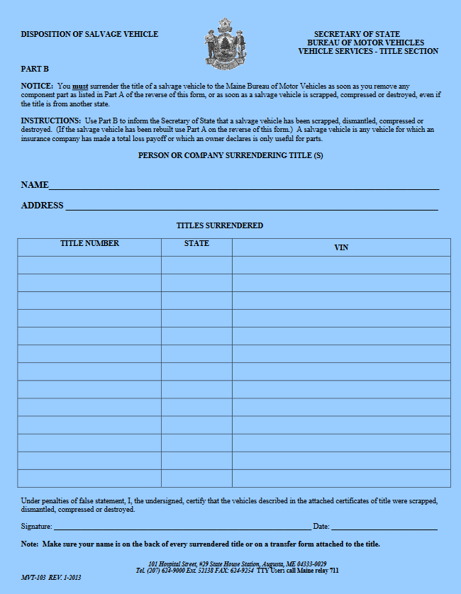
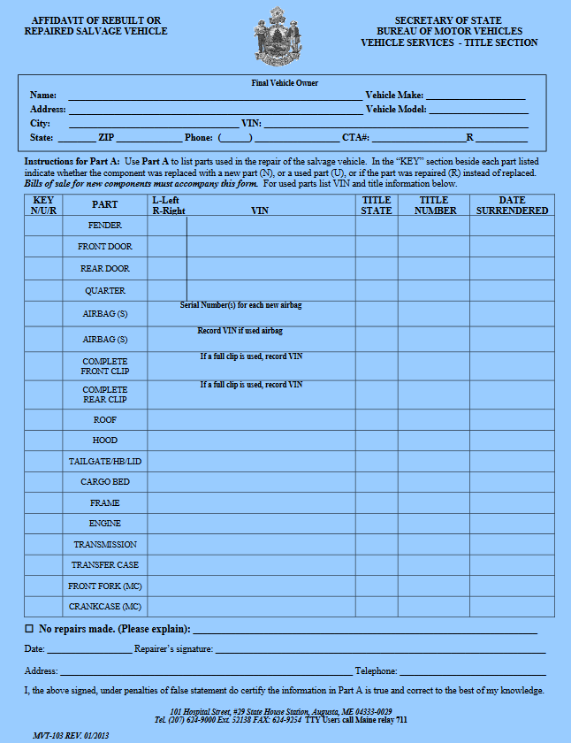
MVT 103
This must be filled out and submitted to the state with the titles you received within 30 days of purchase
Must be used to rebuild a vehicle from salvage to rebuilt / repaired.

Slide 100
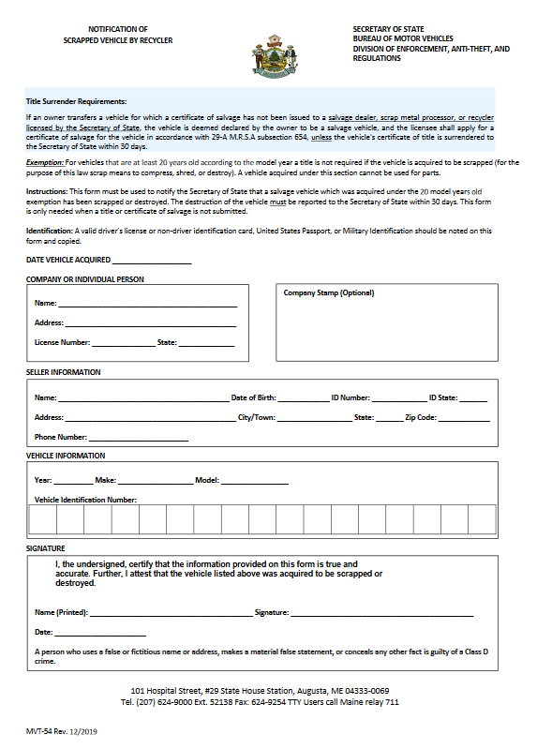
MVT-54
Complete an MVT-54 when purchasing a vehicle that is over 20 year old without title. This form is to be submitted to the state within 30 days of purchase.
(Make sure to keep a copy for your records)
Make sure to be accurate when filling out the Vehicle Identification Number.
(It is Not a bad idea to maintain a photo of the public VIN)
Must have the ID # and State of the sellar.
THIS FORM MUST BE COMPLETED BY THE RECYCLER AND NOT THE PERSON YOU ARE BUYING THE VEHICLE FROM.
!!! Don't Forget that to obtain the sellars information at the time of sale !!!

Slide 101
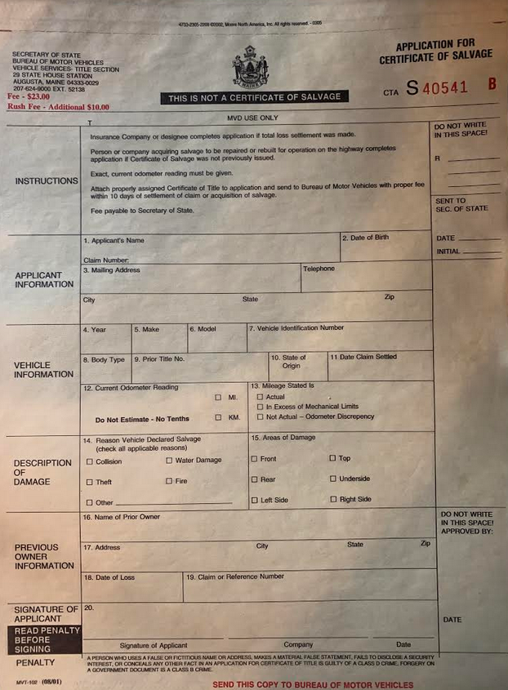
Salvage Title Application
The MVT-102 is to be used when selling a salvage vehicle directly to a customer without rebuilding the vehicle using a MVT-103.
The title application must be submitted to the State by the dealer on behalf of the customer.
A dealer to dealer sale does not require a salvage title application; however a transfer of ownership is required.

Slide 102
Selling a Junked Vehicle
A vehicle that has been submitted to the state as JUNK on a MVT-103 can be sold to a customer using a Bill of Sale.
The Bill of Sale must clearly state that the vehicle is being sold for parts or scrap and can not ever be used on the road way.
!!!!MAKE SURE TO KEEP A COPY OF THIS BILL OF SALE !!!!

Slide 103
What is Inform ME?
InforME (Information Resources of Maine) is the internet gateway for businesses and citizen to interact with governmental electronically.
Inform ME maintains the State of Maine Website
Inform ME has the ability for a fee to check title records for a fee:
Ownership Records
Liens Records
Branded Title Records
Most Current Title.

Slide 104
Thank you for your attention
Detective Ron Mcgowen
Ronald.McGowen@maine.gov
Cell: 207-441-4641
Detective Derek Dinsmore
Derek.Dinsmore@maine.gov
Cell:207-462-2257
Division of Enforcement Anti-Theft and Regulations
207-624-9000

